Slide 1
Mission 6: Discovering Unknown Tactics
In Mission 6, Red’s tactics are completely unknown – and change more than once during the mission.
Your task is to detect the changes, and report the BLUEBOOK values before and after each change.
However, unlike previous missions, the probability of Red attack depends only on P, so there are only two cells in the BLUEBOOK on any trial.
Also unlike previous missions, you are not asked to choose Blue actions on each trial. Instead you will only be reviewing batch plots, for a Red-Blue conflict that has already occurred.
Probability of Red Attack
P > 25%
?%
P ≤ 25%
?%

Slide 2
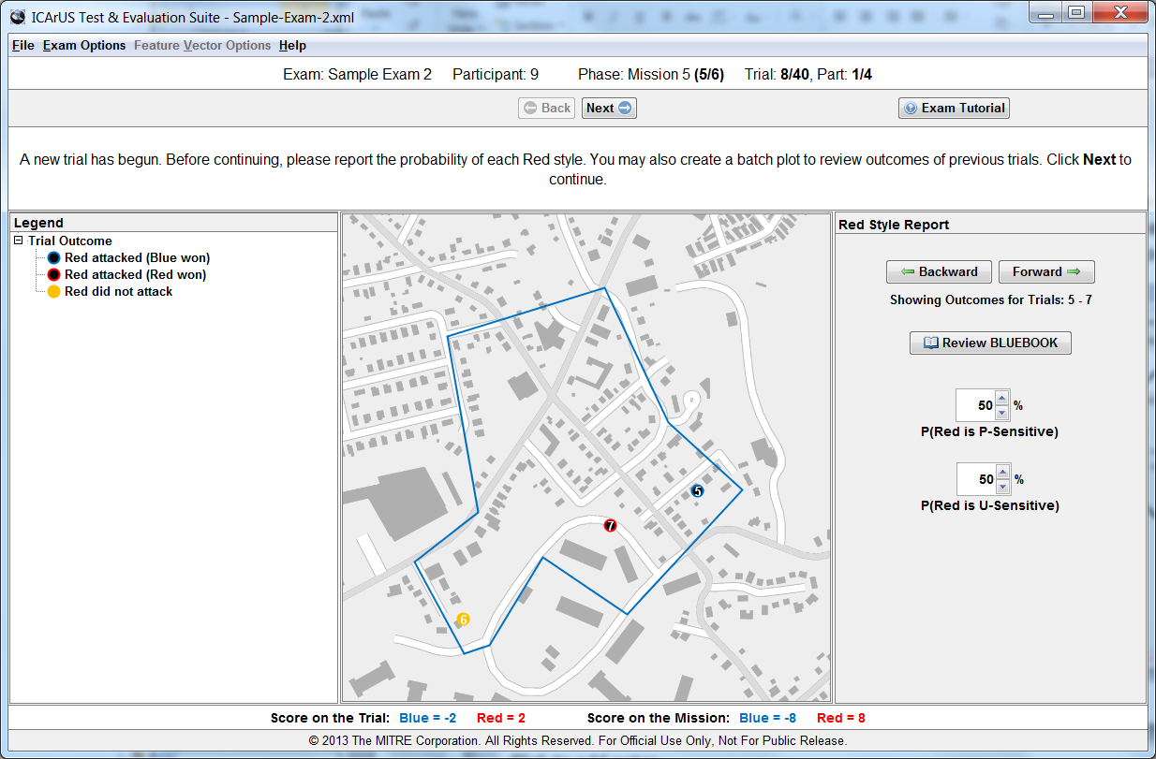
Batch Plot
In Mission 6, batch plots are created much like in Missions 4 and 5, using the “Backward” and “Forward” buttons. However, Mission 6 involves 99 trials, and you can plot outcomes for any and all of these trials.
New GUI

Slide 3
New GUI: Something like this….
How many times did the Red tactics change? ? (1-5)
Trial ?
Trial
?
Trial
?
Trial
?
Trial
?
P > 25%
?%
?%
?%
?%
?%
?%
P ≤ 25%
?%
?%
?%
?%
?%
?%
Note: Number of BLUEBOOKS (2-6) will depend on answer (1-5) to first question.

Slide 4
Red Tactics
Based on batch plots, you are asked to report your judgments about Red tactics – including: (1) number of changes in tactics, (2) trial on which each change occurred, and (3) BLUEBOOK values (probability of Red attack) before and after each change.
New GUI

Slide 5
Your Response
You can enter your responses at any time during your review of batch plots, and you can change your responses as often as you wish. After you are satisfied with your responses, click the “Submit Report” button to conclude Mission 6.
New GUI

Slide 6
Trials
IMPORTANT: Mission 6 involves 99 trials. You can review outcomes for any and all trials, using batch plots, as often as you wish.

